Slide 1

Modular Plan, Query Rewrite, and Materialized View
By Ey-Chih Chow

Slide 2
TPC-DS Q12
select i_item_desc, i_category, i_class, i_current_price, sum(ws_ext_sales_price) as itemrevenue, sum(ws_ext_sales_price)*100/sum(sum(ws_ext_sales_price)) over (partition by i_class) as revenueratio from web_sales, item, date_dim where ws_item_sk = i_item_sk and i_category in ('Sports', 'Books', 'Home') and ws_sold_date_sk = d_date_sk and d_date between cast('1999-02-22' as date) and (cast('1999-02-22' as date) + interval 30 days) group by i_item_id, i_item_desc, i_category, i_class, i_current_price order by i_category, i_class, i_item_id, i_item_desc, revenueratio LIMIT 100

Slide 3
Materialized View
select i_item_desc, i_item_id, i_category, i_class, i_current_price, i_brand_id,
i_class_id, i_category_id, ws_ship_customer_sk, d_year, d_qoy, d_date, sum(ws_quantity*ws_list_price) sales, count(*) number_sales, sum(ws_ext_sales_price) as itemrevenue, sum(ws_net_paid) as total_sum from web_sales, item, date_dim
where ws_item_sk = i_item_sk and ws_sold_date_sk = d_date_sk
group by i_item_id, i_item_desc, i_category, i_category_id, i_class, i_current_price,
i_brand_id,i_class_id,ws_ship_customer_sk,d_year,d_qoy,d_date

Slide 4
Rewritten Query
SELECT gen_subquery_1.`i_item_desc`, gen_subquery_1.`i_category`, gen_subquery_1.`i_class`, gen_subquery_1.`i_current_price`, gen_subquery_1.`itemrevenue`, ((gen_subquery_1.`_w0` * 100.00BD) / CAST(gen_subquery_1.`_we0` AS DECIMAL(28,2))) AS `revenueratio` FROM (SELECT gen_subquery_0.`i_item_desc`, gen_subquery_0.`i_category`, gen_subquery_0.`i_class`, gen_subquery_0.`i_current_price`, gen_subquery_0.`itemrevenue`, gen_subquery_0.`_w0`, gen_subquery_0.`_w1`, gen_subquery_0.`i_item_id`, sum(gen_subquery_0.`_w1`) OVER (PARTITION BY gen_subquery_0.`i_class` ROWS BETWEEN UNBOUNDED PRECEDING AND UNBOUNDED FOLLOWING) AS `_we0` FROM (SELECT gen_subsumer_0.`i_item_desc`, gen_subsumer_0.`i_category`, gen_subsumer_0.`i_class`, gen_subsumer_0.`i_current_price`, gen_subsumer_0.`itemrevenue` AS `itemrevenue`, gen_subsumer_0.`itemrevenue` AS `_w0`, gen_subsumer_0.`itemrevenue` AS `_w1`, gen_subsumer_0.`i_item_id` FROM (SELECT item.`i_item_desc`, item.`i_item_id`, item.`i_category`, item.`i_class`, item.`i_current_price`, item.`i_brand_id`, item.`i_class_id`, item.`i_category_id`, web_sales.`ws_ship_customer_sk`, date_dim.`d_year`, date_dim.`d_qoy`, date_dim.`d_date`, sum((CAST(CAST(web_sales.`ws_quantity` AS DECIMAL(10,0)) AS DECIMAL(12,2)) * CAST(web_sales.`ws_list_price` AS DECIMAL(12,2)))) AS `sales`, count(1) AS `number_sales`, makedecimal(sum(unscaledvalue(web_sales.`ws_ext_sales_price`))) AS `itemrevenue`, makedecimal(sum(unscaledvalue(web_sales.`ws_net_paid`))) AS `total_sum` FROM web_sales INNER JOIN item ON (web_sales.`ws_item_sk` = item.`i_item_sk`) INNER JOIN date_dim ON (web_sales.`ws_sold_date_sk` = date_dim.`d_date_sk`) GROUP BY item.`i_item_id`, item.`i_item_desc`, item.`i_category`, item.`i_category_id`, item.`i_class`, item.`i_current_price`, item.`i_brand_id`, item.`i_class_id`, web_sales.`ws_ship_customer_sk`, date_dim.`d_year`, date_dim.`d_qoy`, date_dim.`d_date`) gen_subsumer_0 WHERE (gen_subsumer_0.`i_category` IN ('Sports', 'Books', 'Home')) AND (gen_subsumer_0.`d_date` >= DATE '1999-02-22') AND (gen_subsumer_0.`d_date` <= DATE '1999-03-24') GROUP BY gen_subsumer_0.`i_item_id`, gen_subsumer_0.`i_item_desc`, gen_subsumer_0.`i_category`, gen_subsumer_0.`i_class`, gen_subsumer_0.`i_current_price`) gen_subquery_0 ) gen_subquery_1 ORDER BY gen_subquery_1.`i_category` ASC NULLS FIRST, gen_subquery_1.`i_class` ASC NULLS FIRST, gen_subquery_1.`i_item_id` ASC NULLS FIRST, gen_subquery_1.`i_item_desc` ASC NULLS FIRST, `revenueratio` ASC NULLS FIRST LIMIT 100

Slide 5
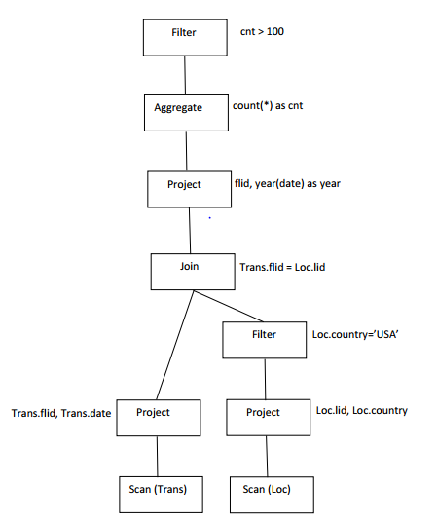
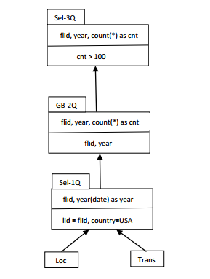
Logical vs. Modular Plan
Logical Plan
Modular Plan

Slide 6
Analyzed Logical Plan
===== Analyzed Logical Plan for q12 ===== GlobalLimit 100 +- LocalLimit 100 +- Project [i_item_desc#40, i_category#48, i_class#46, i_current_price#41, itemrevenue#0, revenueratio#1] +- Sort [i_category#48 ASC NULLS FIRST, i_class#46 ASC NULLS FIRST, i_item_id#37 ASC NULLS FIRST, i_item_desc#40 ASC NULLS FIRST, revenueratio#1 ASC NULLS FIRST], true +- Project [i_item_desc#40, i_category#48, i_class#46, i_current_price#41, itemrevenue#0, revenueratio#1, i_item_id#37] +- Project [i_item_desc#40, i_category#48, i_class#46, i_current_price#41, itemrevenue#0, _w0#90, _w1#91, _we0#92, CheckOverflow((promote_precision(cast(CheckOverflow((promote_precision(cast(_w0#90 as decimal(17,2))) * promote_precision(cast(cast(100 as decimal(10,0)) as decimal(17,2)))), DecimalType(28,2)) as decimal(28,2))) / promote_precision(cast(_we0#92 as decimal(28,2)))), DecimalType(38,19)) AS revenueratio#1, i_item_id#37] +- Window [sum(_w1#91) windowspecdefinition(i_class#46, ROWS BETWEEN UNBOUNDED PRECEDING AND UNBOUNDED FOLLOWING) AS _we0#92], [i_class#46] +- Aggregate [i_item_id#37, i_item_desc#40, i_category#48, i_class#46, i_current_price#41], [i_item_desc#40, i_category#48, i_class#46, i_current_price#41, sum(ws_ext_sales_price#25) AS itemrevenue#0, sum(ws_ext_sales_price#25) AS _w0#90, sum(ws_ext_sales_price#25) AS _w1#91, i_item_id#37] +- Filter (((ws_item_sk#5 = i_item_sk#36) && i_category#48 IN (Sports,Books,Home)) && ((ws_sold_date_sk#2 = d_date_sk#58) && ((d_date#60 >= cast(1999-02-22 as date)) && (d_date#60 <= cast(cast(cast(1999-02-22 as date) as timestamp) + interval 4 weeks 2 days as date))))) +- Join Inner :- Join Inner : :- MetastoreRelation default, web_sales : +- MetastoreRelation default, item +- MetastoreRelation default, date_dim

Slide 7
Optimized Logical Plan
===== Optimized Logical Plan for q12 ===== GlobalLimit 100 +- LocalLimit 100 +- Project [i_item_desc#40, i_category#48, i_class#46, i_current_price#41, itemrevenue#0, revenueratio#1] +- Sort [i_category#48 ASC NULLS FIRST, i_class#46 ASC NULLS FIRST, i_item_id#37 ASC NULLS FIRST, i_item_desc#40 ASC NULLS FIRST, revenueratio#1 ASC NULLS FIRST], true +- Project [i_item_desc#40, i_category#48, i_class#46, i_current_price#41, itemrevenue#0, CheckOverflow((CheckOverflow((_w0#90 * 100.00), DecimalType(28,2)) / cast(_we0#92 as decimal(28,2))), DecimalType(38,19)) AS revenueratio#1, i_item_id#37] +- Window [sum(_w1#91) windowspecdefinition(i_class#46, ROWS BETWEEN UNBOUNDED PRECEDING AND UNBOUNDED FOLLOWING) AS _we0#92], [i_class#46] +- Aggregate [i_item_id#37, i_item_desc#40, i_category#48, i_class#46, i_current_price#41], [i_item_desc#40, i_category#48, i_class#46, i_current_price#41, MakeDecimal(sum(UnscaledValue(ws_ext_sales_price#25)),17,2) AS itemrevenue#0, MakeDecimal(sum(UnscaledValue(ws_ext_sales_price#25)),17,2) AS _w0#90, MakeDecimal(sum(UnscaledValue(ws_ext_sales_price#25)),17,2) AS _w1#91, i_item_id#37] +- Project [ws_ext_sales_price#25, i_item_id#37, i_item_desc#40, i_current_price#41, i_class#46, i_category#48] +- Join Inner, (ws_sold_date_sk#2 = d_date_sk#58) :- Project [ws_sold_date_sk#2, ws_ext_sales_price#25, i_item_id#37, i_item_desc#40, i_current_price#41, i_class#46, i_category#48] : +- Join Inner, (ws_item_sk#5 = i_item_sk#36) : :- Project [ws_sold_date_sk#2, ws_item_sk#5, ws_ext_sales_price#25] : : +- MetastoreRelation default, web_sales : +- Project [i_item_sk#36, i_item_id#37, i_item_desc#40, i_current_price#41, i_class#46, i_category#48] : +- Filter i_category#48 IN (Sports,Books,Home) : +- MetastoreRelation default, item +- Project [d_date_sk#58] +- Filter ((d_date#60 >= 10644) && (d_date#60 <= 10674)) +- MetastoreRelation default, date_dim

Slide 8
Modular Plan
===== MODULAR PLAN for q12 ===== !Select [i_item_desc#40, i_category#48, i_class#46, i_current_price#41, itemrevenue#0, CheckOverflow((CheckOverflow((_w0#90 * 100.00), DecimalType(28,2)) / cast(_we0#92 as decimal(28,2))), DecimalType(38,19)) AS revenueratio#1], [i_item_desc#40, i_category#48, i_class#46, i_current_price#41, itemrevenue#0, _w0#90, _w1#91, i_item_id#37, _we0#92], 14, [List(100), List(ArrayBuffer(i_category#48 ASC NULLS FIRST, i_class#46 ASC NULLS FIRST, i_item_id#37 ASC NULLS FIRST, i_item_desc#40 ASC NULLS FIRST, revenueratio#1 ASC NULLS FIRST))] +- Select [i_item_desc#40, i_category#48, i_class#46, i_current_price#41, itemrevenue#0, _w0#90, _w1#91, i_item_id#37], [i_item_desc#40, i_category#48, i_class#46, i_current_price#41, itemrevenue#0, _w0#90, _w1#91, i_item_id#37], 0, [List(ArrayBuffer(sum(_w1#91) windowspecdefinition(i_class#46, ROWS BETWEEN UNBOUNDED PRECEDING AND UNBOUNDED FOLLOWING) AS _we0#92))] +- !Select [i_item_desc#40, i_category#48, i_class#46, i_current_price#41, MakeDecimal(sum(UnscaledValue(ws_ext_sales_price#25)),17,2) AS itemrevenue#0, MakeDecimal(sum(UnscaledValue(ws_ext_sales_price#25)),17,2) AS _w0#90, MakeDecimal(sum(UnscaledValue(ws_ext_sales_price#25)),17,2) AS _w1#91, i_item_id#37], [ws_ext_sales_price#25, i_item_id#37, i_item_desc#40, i_current_price#41, i_class#46, i_category#48], 0 +- GroupBy [i_item_desc#40, i_category#48, i_class#46, i_current_price#41, MakeDecimal(sum(UnscaledValue(ws_ext_sales_price#25)),17,2) AS itemrevenue#0, MakeDecimal(sum(UnscaledValue(ws_ext_sales_price#25)),17,2) AS _w0#90, MakeDecimal(sum(UnscaledValue(ws_ext_sales_price#25)),17,2) AS _w1#91, i_item_id#37], [ws_ext_sales_price#25, i_item_id#37, i_item_desc#40, i_current_price#41, i_class#46, i_category#48], [i_item_id#37, i_item_desc#40, i_category#48, i_class#46, i_current_price#41], 0 +- Select [ws_ext_sales_price#25, i_item_id#37, i_item_desc#40, i_current_price#41, i_class#46, i_category#48], [ws_sold_date_sk#2, ws_sold_time_sk#3, ws_ship_date_sk#4, ws_item_sk#5, ws_bill_customer_sk#6, ws_bill_cdemo_sk#7, ws_bill_hdemo_sk#8, ws_bill_addr_sk#9, ws_ship_customer_sk#10, ws_ship_cdemo_sk#11, ws_ship_hdemo_sk#12, ws_ship_addr_sk#13, ws_web_page_sk#14, ws_web_site_sk#15, ws_ship_mode_sk#16, ws_warehouse_sk#17, ws_promo_sk#18, ws_order_number#19L, ws_quantity#20, ws_wholesale_cost#21, ws_list_price#22, ws_sales_price#23, ws_ext_discount_amt#24, ws_ext_sales_price#25, ... 60 more fields], [i_category#48 IN (Sports,Books,Home), (ws_item_sk#5 = i_item_sk#36), (d_date#60 >= 10644), (d_date#60 <= 10674), (ws_sold_date_sk#2 = d_date_sk#58)], Map(0 -> web_sales, 1 -> item, 2 -> date_dim), [JoinEdge(0,1,Inner), JoinEdge(0,2,Inner)], 0 :- ModularTable default, web_sales, [ws_sold_date_sk#2, ws_sold_time_sk#3, ws_ship_date_sk#4, ws_item_sk#5, ws_bill_customer_sk#6, ws_bill_cdemo_sk#7, ws_bill_hdemo_sk#8, ws_bill_addr_sk#9, ws_ship_customer_sk#10, ws_ship_cdemo_sk#11, ws_ship_hdemo_sk#12, ws_ship_addr_sk#13, ws_web_page_sk#14, ws_web_site_sk#15, ws_ship_mode_sk#16, ws_warehouse_sk#17, ws_promo_sk#18, ws_order_number#19L, ws_quantity#20, ws_wholesale_cost#21, ws_list_price#22, ws_sales_price#23, ws_ext_discount_amt#24, ws_ext_sales_price#25, ... 10 more fields], 0 :- ModularTable default, item, [i_item_sk#36, i_item_id#37, i_rec_start_date#38, i_rec_end_date#39, i_item_desc#40, i_current_price#41, i_wholesale_cost#42, i_brand_id#43, i_brand#44, i_class_id#45, i_class#46, i_category_id#47, i_category#48, i_manufact_id#49, i_manufact#50, i_size#51, i_formulation#52, i_color#53, i_units#54, i_container#55, i_manager_id#56, i_product_name#57], 0 +- ModularTable default, date_dim, [d_date_sk#58, d_date_id#59, d_date#60, d_month_seq#61, d_week_seq#62, d_quarter_seq#63, d_year#64, d_dow#65, d_moy#66, d_dom#67, d_qoy#68, d_fy_year#69, d_fy_quarter_seq#70, d_fy_week_seq#71, d_day_name#72, d_quarter_name#73, d_holiday#74, d_weekend#75, d_following_holiday#76, d_first_dom#77, d_last_dom#78, d_same_day_ly#79, d_same_day_lq#80, d_current_day#81, ... 4 more fields], 0

Slide 9
Why Modular Plan
Modularize query rewrite
Rule-based rewrite, e.g.
SelectSelectNoChildDelta
GroupbyGroupbySelectOnlyChildDelta
SelectSelectGroupbyChildDelta
Maximal use of SparkSQL internal libraries, e.g.
TreeNode – transform(rule: PartialFunction[BaseType,BaseType]): BaseType
QueryPlan – transformExpressions(rule: PartialFunction[Expression,Expression]): this.type
Expressions, including aggregates – semanticEquals(other:Expression): Boolean, sql method of Expression, Alias, Attribute, etc.

Slide 10
Design of class Arguments for Modular Plan
Core of transformExpressions
def recursiveTransform(arg: Any): AnyRef = arg match { case e: Expression => transformExpressionDown(e) case Some(e: Expression) => Some(transformExpressionDown(e)) case m: Map[_, _] => m case d: DataType => d // Avoid unpacking Structs case seq: Traversable[_] => seq.map(recursiveTransform) case other: AnyRef => other case null => null }
case class Select(outputList: Seq[NamedExpression],
inputList: Seq[Expression],
predicateList: Seq[Expression],
aliasMap: Map[Int, String],
joinEdges: Seq[JoinEdge],
children: Seq[ModularPlan],
flags: FlagSet,
flagSpec: Seq[Seq[Any]] ,
windowSpec: Seq[Seq[Any]])

Slide 11
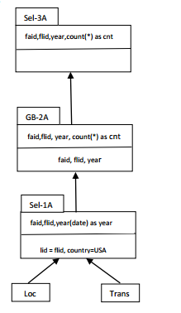
Matching Framework
Query
MV

Slide 12
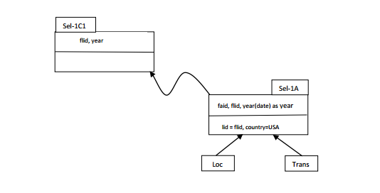
Rule #1: Select-Select-NoChildDelta

Slide 13
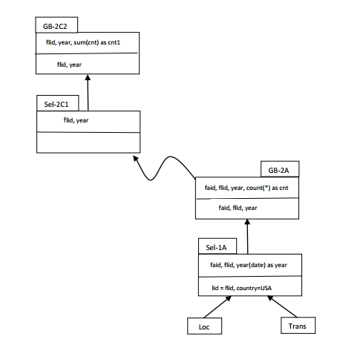
Rule #2: Groupby-Groupby-SelectOnlyChildDelta

Slide 14
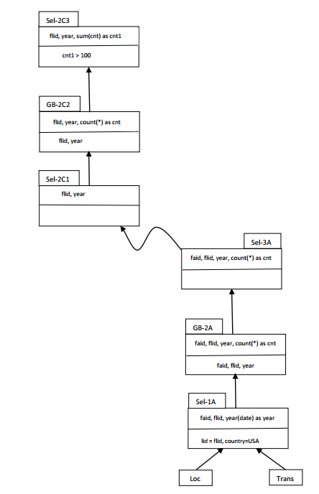
Rule #3: Select-Select-GroupbyChildDelta

Slide 15
From Modular Plan to SQL
[SPARK-12593] Converts resolved logical plan back to SQL
SQLBuilder.toSQL
Scala compiler – coverts Scala AST to Scala code fragment using DSL

Slide 16
Extensions
Union and subqueries
Need a navigator
Cube advisor
Find covering queries as MVs or Cache
Carbon Data
Lineage data for ExtendedCatalog

Slide 17
Extended Catalog
MV Definitions – derived from lineage info
Materialized Views saved in the form of CarbonData
Lineage described logically by SQL query and its input tables
Cache Definitions – derived from cacheData (ArrayBuffer[CachedData]) in CacheManager

Slide 18
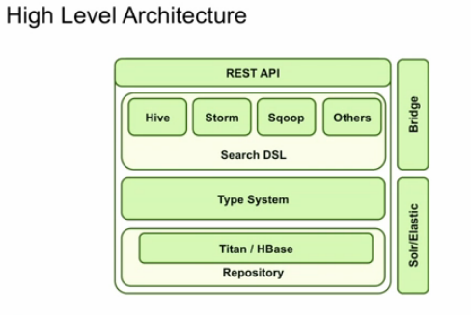
Lineage Data

Slide 19
From Logical to Modular Plan
A Logical Plan is transformed to a Modular Plan by applying a set of Pattern Extractions
Every Pattern Extraction uses pattern matching to convert a Tree to another kind of Tree
object GroupByBlock extends Pattern with PredicateHelper {
…
def apply(plan: LogicalPlan): Seq[SemanticPlan] = plan match {
case ExtractGroupBy(output, input, predicate, child) =>
makeGroupByBlock(output, input, predicate, matchLater(child))
case _ => Nil
}
} Triggers other Patten Extractions

